Slide 1



Automation Factory
Sample RPA project (PoC/Pilot) delivery plan
8th Jan 2020

Slide 2



High level plan for RPA PoC/Pilot development
Project Kickoff
Toll-gate
Go-Live
1
Week -1
Week 1
Week 2
Week 3
Week 4
Week 5
Week 6
Week 7
Week 8
Week 9
Ongoing
Pre activities
Phase 1
Phase 2
Phase 3
Setting the project framework and governance structure.
Reviewing and agreeing on the pre-requisites needed for remote solution development.
Scheduling an onboarding session for the project team mainly covering the Release Management and Platform support topics
2
Process Analysis & Solution design
PoC – Bot/artifact is developed in dev/test environment
Output
Sample RPA PoC/Pilot Project delivery plan with indicative timelines
CPAR
Product Owner to Sign-off the CPAR document
Pilot – Bot/artifact is tested in Pre-production environment and deployed in production environment
RPA IT Infrastructure setup and access to Roche applications (to be secured by Roche project & RPA support team respectively)
3
Output
4
PoC Demo
Configuration, development, testing
Ongoing Artifact/bot run and maintenance
services
Simple complexity
UAT
Medium complexity
The overall RPA pilot project plan consists of 4 Blocks, to be completed in the sequential order
High complexity
Output
Output
UAT Report
AOH
0% - 10%
11% - 25%
Effort estimate expected from Roche BU
26% - 50%
Roche BU
51% - 75%
Product Owner
Business Analyst (process SME)
Application IT (SPOC)
76% - 100%

Slide 3

Block descriptions (key activities, expectation from Roche BU (client) and deliverables)
Sample RPA PoC activities and deliverables
Key activities
Expectation from Roche BU
Deliverables
1. Mobilisation of AF resources
2. Detailed RPA Programme planning
Creating the detailed RPA Project Plan created
Agreeing on project documentation principles
3. Define the communication plan
Stakeholders mapping – creation of Team members register
Create Communication Planning and Estalation plan along with a RACI matrix
Roche BU (client) to secure all the resources/roles needed for this PoC project as per the planned timeline (details are mentioned in each block description)
All required access rights to the concerned applications/systems for AF’s developers and SME’s availability should be secured by Product Owner during Block 1
Roche BU (client) roles
Involvement
1.1a Resources needed identified
1.1b Resources mobilized and made available according to the project plan
1.2a Detailed Project Plan
1.2b Project documentation principles and templates agreed
1.3a Stakeholders register
1.3b Communication plan
Pre activities
Product Owner
Process SME
Application IT (SPOC)
1
1. Automation solution design documentation
1 weeks remote work including workshops
Business Requirements collection and documentation
Deep dive into the process to understand automation scope including process recording
RPA UAT test scenarios initial backlog creation
Test scenarios to prepared and confirmed by process SME
2. Detailed RPA Developement planning
Creating detailed RPA Project Plan
Agreeing on the Project documentation principles
1. Process SME should be available (50%) for the one week (5 working days /20 hours) for remote workshop with AF’s RPA Business Analyst (BA).
2. Process SME should share all the process related inputs requested by AF’s BA which will be required for crafting the RPA Solution document
3. Process SME needs to review and sign-off the CPAR (solution design) document
Roche BU (client) roles
Involvement
2.1a Current Process & Automation Requirements (CPAR) document
2.1b RPA SIT scope
2.2a RPA Development plan
Product Owner
Process SME
Application IT (SPOC)
2
Process Analysis & Solution design
RPA IT Infrastructure setup and access to Roche applications
Secure the required access rights to all the concerned applications used within the process, RPA software’s etc. for our RPA developers
Laptops/VM’s with required level of access rights
1. Roche Application IT support team is responsible for providing the required access to test and production environment of the concerned applications
Roche BU (client) roles
Involvement
1. All of the pre-requisites must be completed by App IT support team at least one week before the start date of development phase. Any delay will have impact the overall timeline of the project.
3
Application IT (SPOC)
1. Detailed RPA Development planning
Backlog creation
2. Artefacts Development
Development using AF’s best practices and coding standards
3. Functional Testing
Integration testing and code review
4. PoC Demo
AF team will provide an end-to-end demo of the developed artefact for the project team and key stakeholders
1. App IT SPOC should provide the requested support and assistance to AF’s RPA developers for all issues related to system/application access and
connectivity
3. Roche SME needs to make sure that enough test data is available in test environment for the AF developers to perform the internal test (SIT)
2. Considering this is a PoC project so there won’t be any UAT performed for this use case
Roche BU (client) roles
Involvement
4.1a Backlog created and sprints planned
4.2a Artefacts created as per CPAR
4.3a System Integration testing
4.4a RPA PoC demo recording
Product Owner
Process SME
Application IT (SPOC)
4
Configuration, development, System Integration testing
0% - 10%
51% - 75%
11% - 25%
76% - 100%
26% - 50%

Slide 4
Block descriptions (key activities, expectation from Roche BU (client) and deliverables)
Sample RPA Pilot activities and deliverables
Key activities
Expectation from Roche BU
Deliverables
1. Mobilisation of AF resources
2. Detailed RPA Programme planning
Creating the detailed RPA Project Plan created
Agreeing on project documentation principles
3. Define the communication plan
Stakeholders mapping – creation of Team members register
Create Communication Planning and Estalation plan along with a RACI matrix
Roche BU (client) to secure all the resources/roles needed for this Pilot project as per the planned timeline (details are mentioned in each block description)
All required access rights to the concerned applications/systems for AF’s developers and SME’s availability should be secured by Product Owner during Block 1
Roche BU (client) roles
Involvement
1.1a Resources needed identified
1.1b Resources mobilized and made available according to the project plan
1.2a Detailed Project Plan
1.2b Project documentation principles and templates agreed
1.3a Stakeholders register
1.3b Communication plan
Pre activities
Product Owner
Process SME
Application IT (SPOC)
1
1. Automation solution design documentation
1 weeks remote work including workshops
Business Requirements collection and documentation
Deep dive into the process to understand automation scope including process recording
RPA UAT test scenarios initial backlog creation
Test scenarios to prepared and confirmed by process SME
2. Detailed RPA Developement planning
Creating detailed RPA Project Plan
Agreeing on the Project documentation principles
1. Process SME should be available (100%) for the one week (5 working days /40 hours) for remote workshop with AF’s RPA Business Analyst (BA).
2. Process SME should share all the process related inputs requested by AF’s BA which will be required for crafting the RPA Solution document
3. Process SME needs to review and sign-off the CPAR (solution design) document
Roche BU (client) roles
Involvement
2.1a Current Process & Automation Requirements (CPAR) document
2.1b RPA UAT test scenarios & test data
2.2a RPA Development plan
Product Owner
Process SME
Application IT (SPOC)
2
Process Analysis & Solution design
RPA IT Infrastructure setup and access to Roche applications
Secure the required access rights to all the concerned applications used within the process, RPA software’s etc. for our RPA developers
Laptops/VM’s with required level of access rights
1. Roche Application IT support team is responsible for providing the required access to test and production environment of the concerned applications
Roche BU (client) roles
Involvement
1. All of the pre-requisites must be completed by App IT support team at least one week before the start date of development phase. Any delay will have impact the overall timeline of the project.
3
Application IT (SPOC)
1. Detailed RPA Development planning
Backlog creation
2. Artefacts Development
Development using AF’s best practices and coding standards
3. Testing
Integration testing and code review
User Acceptance Testing (to be performed by process SME in coordination with AF team)
4. Deployment of artefacts/bots in production
1. App IT SPOC should provide the requested support and assistance to AF’s RPA developers for all issues related to system/application access and connectivity
2. Process SME should prepare and finalize the test scenarios during the Solution design phase
3. Process SME will lead the UAT phase with the support of AF team (Dev & BA)
Roche BU (client) roles
Involvement
4.1a Backlog created and sprints planned
4.2a Artefacts created as per CPAR
4.2b Reusable components of the artefacts
4.3a System Integration testing
4.3b UAT report
4.3c Kibana dashboard
4.4a Artefact Operational Handbooks (AOH)
4.4b Efficiency, effectiveness and controls realized through the automated processes
Product Owner
Process BA SME
Application IT (SPOC)
4
Configuration, development, testing and deployment
0% - 10%
51% - 75%
11% - 25%
76% - 100%
26% - 50%

Slide 5
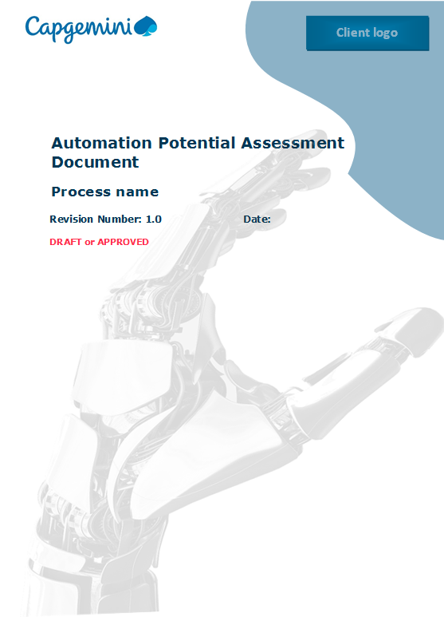
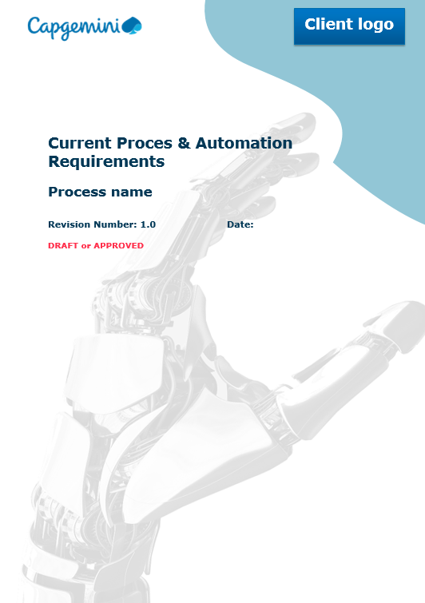
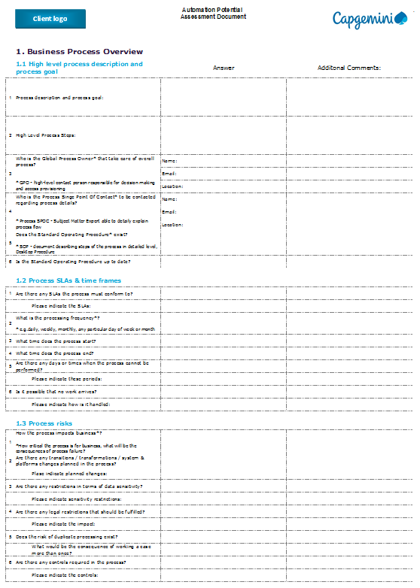
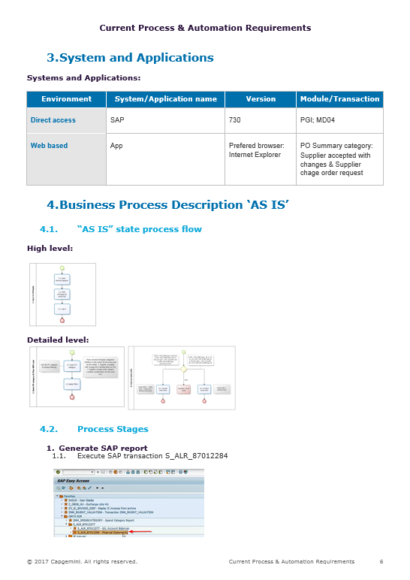
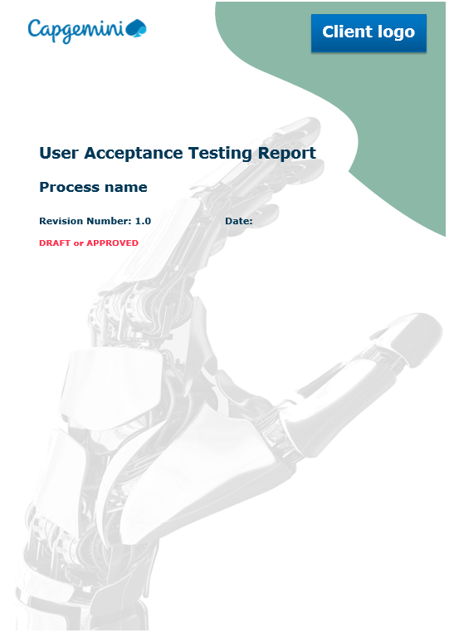
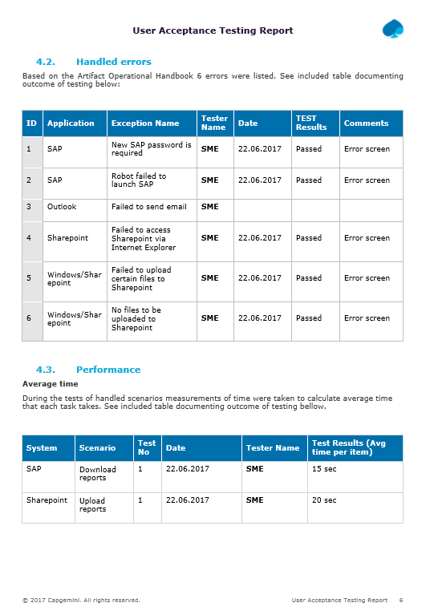
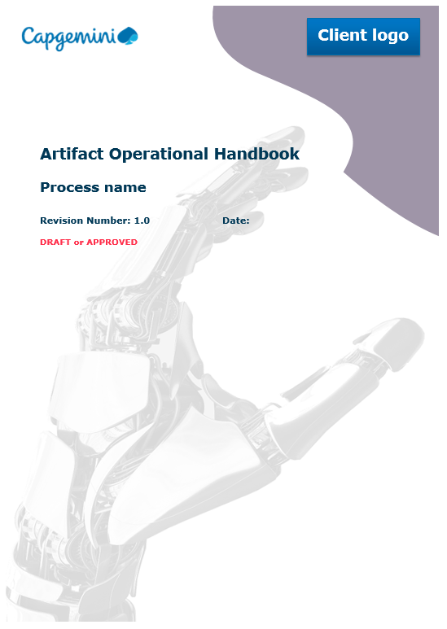
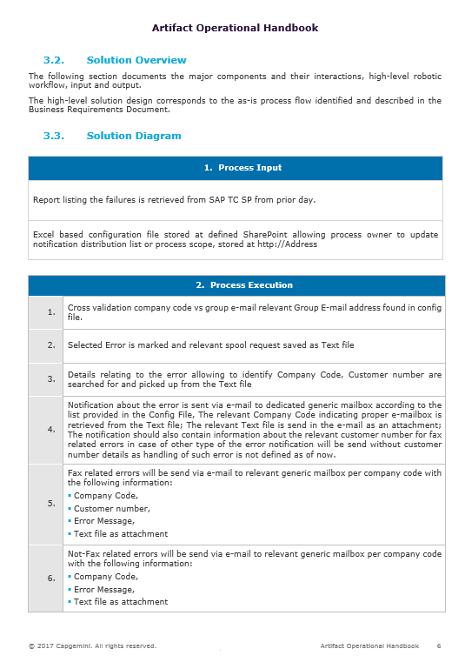
RPA documentation approach ensuring reuse and sharing
This ensures that all artefacts will be developed and tested in high quality for full compliance and audit readiness
1
2
Automation Potential Assessment Document (APAD)
Current Process & Automation Requirements (CPAR)
High level process data and description
Detailed process description containing the description of an Artefact and its exceptions broken down to click level activities, listing RPA requirements.
3
4
Integration / UAT Test Documentation examples
Artifact Operational Handbook (AOH) (As Is Robotized)
Description of tests performed on a particular Artefact with the collection of documents and formal closing of the particular Artefact’s development phase
A set of detailed Instructions on how to use a particular Artefact and the description of exceptions that can take place and why

Slide 6



Automation Factory’s recommended and proven testing methodology
Scenarios
Scenarios
User Story specification and TO – BE Solution Design
Test Scenarios
Test Run
Test Results Validation
Bugs to be
fixed
1
2
3
4
5
Implementation of use cases
If needed stages 3 – 5 are iterated
Architect prepares test scenarios based on User Story specification and TO – BE solution design; identifies needs for performance tests.
Architect works closely with developer and SME during the process of specifying test scenarios. Scenarios should comply with worked out solution design of the artifact(s).
Test items will be registered in Jira backlog (Test’ issue type)
Details will be specified in excel file stored in Confluence project page and linked to each‚Test’ issue (see details on next slides)
Developer conducts internal tests and provides results in a form of output files, videos, screens (or any other proof / documentation) to Architect (via uploading to Confluence project page, and linking to given ‚Test’ issue type).
Architect / SME validates test results. Marks which scenario passed test, which failed.
Architect registers in Jira discovered bugs (Bug’ issue type) and assign it to the developer for a fix.
Step 1
Step 2
Step 3
Step 4
Step 5

